Slide 1
Bullying
Name
Institution
Date

Slide 2
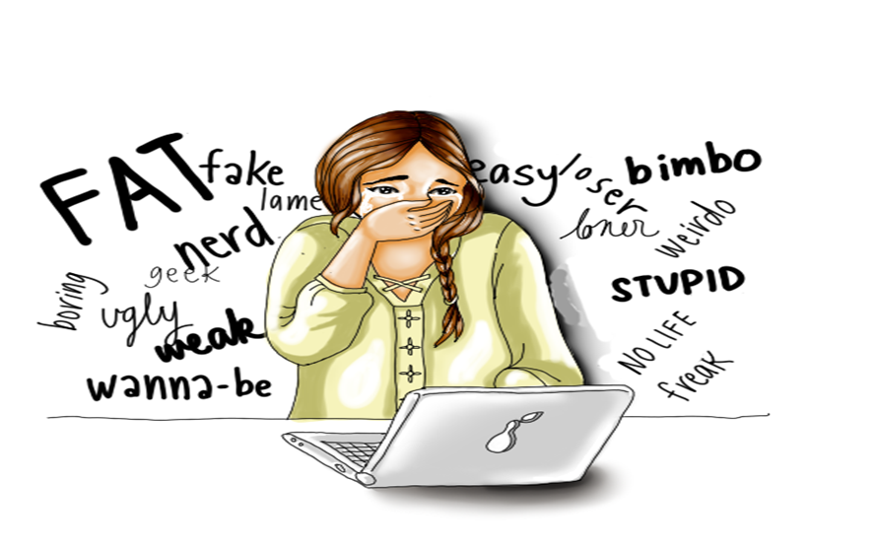
Introduction on Bullying
Bullying refers to the habitual use of coercion, threats and other forms of aggressive behaviour to intimidate or dominate other people (Menesini & Salmivalli, 2017)
Bullying results to social malfunctioning to the victim
Notes:
Bullying is described as the habitual behaviour characterized by a person using aggression, threat or abuse to dominate or intimidate other people (Menesini & Salmivalli, 2017).

Slide 3
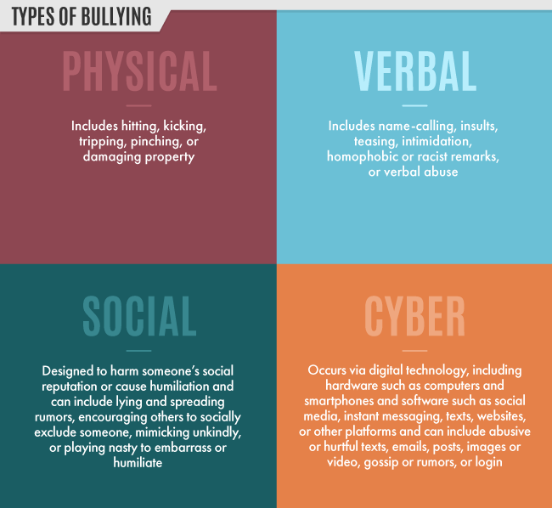
Forms of Bullying
  The major forms of bullying in society include;
    Physical bullying
    Social bullying
    Verbal bullying
    Cyberbullying (Olweus & Limber, 2018).
Notes:
There are different forms of bullying namely; physical bullying social bullying, verbal bullying and cyber bullying. Physical bullying involves causing long term or short-term damage by kicking, punching, hitting or pushing the other person. Social bullying takes place behind a persons back with the intention of ruining their reputation. Some forms of social bullying include spreading rumours, telling others to exclude certain people in activities and playing mean jokes to humiliate the other person.
Verbal bullying takes the form of making racist or homophobic comments about other people, teasing, hurling insults and physical intimidation. On the other hand, cyberbullying is a form of bullying that is done through the use of electronic devices such as phones and computers (Olweus & Limber 2018). Cyberbullying can be in the form of sending hurtful messages, videos or images about other people so they can be humiliated online.

Slide 4
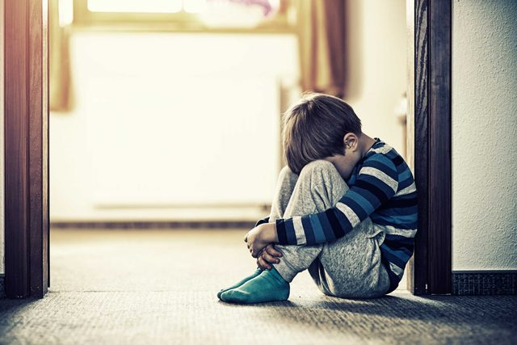
Signs that a Child is being Bullied
  Some of the signs that a child is being bullied are;
    Unexplained bruises, cuts and scratches
    Changes in eating habits
    Challenges in sleeping
    Loss of interest in school
    Declining self-esteem
Notes:
There are some signs which are noticeable when a child is being bullied. One can tell if a child is being bullied if they have unexplained injuries most of the time.
If a child happens to show a shift in eating habits, there is a likelihood that they are being bullied. For example, if a child comes from school and eats a lot of food, that could be an indicator that they do not eat their lunch at school. If children begin to have frequent nightmares or lose sleep, it may also be a sign they are being bullied. If a child is being bullied in school, they are likely to lose interest in school attendance, school work and try to make excuses to miss school. Declining self-esteem in a child is also a sign that others are bullying them.

Slide 5
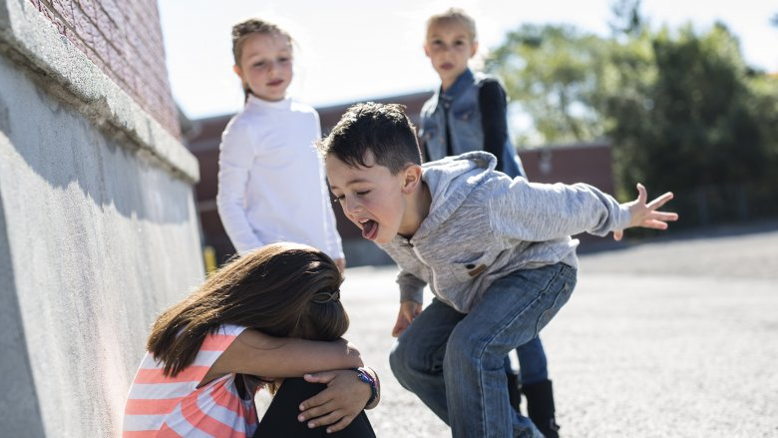
Signs that a child is a bully
Some of the signs that prove your child might be the bully are;
  Gets into physical or verbal fights
  Unexplained new belongings or money
  Increased aggression
  Gets frequent detention
  Blames other people for their mistakes
Notes:
There are certain signs that can be used to tell if your child is the one bullying others. If a child keeps getting into physical and verbal fights with their peers, this could be a sign that they are a bully. Increased display of aggressive behaviour in a child is also an indicator that they are a bully. If a child keeps getting detention in school continuously because of aggressive behaviour, they are likely to be a bully in school. If a child keeps blaming other people for their mistakes instead of owning up to them, this is a sign that they are a bully. If a child has accumulated extra money and belongings that they can not explain where they got from then, there is a high chance that they are bullying others.

Slide 6
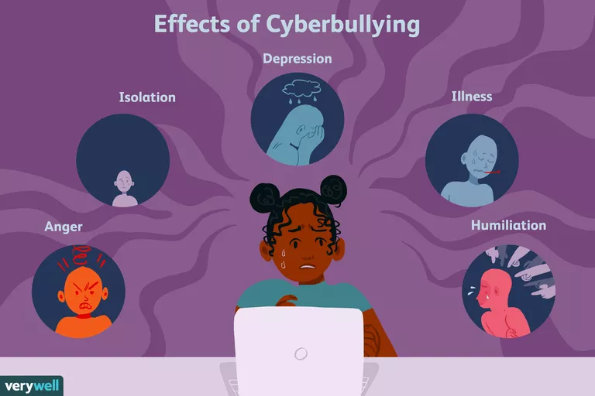
Effects of Bullying
Bullying has several adverse effects and these include:
  Social isolation
  Low self-esteem
  Chronic depression (Arseneault, 2017)
  Suicidal attempts
  Poor school performance
Notes:
Bullying has serious short-term and long-term effects on individuals including; victims of bullying often tend to self-isolate and most hours alone to avoid being further humiliated or harmed by the bullies. Victims of bullying also tend to develop low self-esteem, especially if they are being bullied for their physical appearances. Victims of bullying also develop chronic depression if the bullying goes unnoticed for extended periods (Arseneault, 2017). This may translate to suicide attempts. Children who are bullied in school also tend to have poor academic performance because they feel demotivated and threatened while in the school environment.

Slide 7
The Relationship Between Bullying and Suicide
There exists between bullying and suicide attempts.
Bullying triggers feelings of low self-worth and depression
Continuous bullying over extended periods can cause a child to attempt suicide
Notes:
Research proves that suicide attempts are at times triggered by frequent bullying over a long period of time. This is because the victims develop low self-worth and chronic depression, which, if untreated, results in loss of hope for life. Victims of bullying resort to suicide if their environment is hostile and unsupportive of what they are going through, either physically or mentally.

Slide 8
Bullying Statistics
According to the national bullying prevention center (2020);
  About 20.2 % of students undergo bullying while at school
  Physical bullying is higher in males than females
  School-based bullying prevention programs decrease bullying by up to 25%.
Notes:
Bullying statistics from the national bullying prevention center indicate that males are more likely than females to undergo physical bullying.
20.2 % of bullying happens within school premises. Bullying prevention programs in schools tend to reduce bullying by approximately 25%.

Slide 9
Groups Prone to be Bullied
Some of the people most prone to be bullied include;
  Overweight children
  Children with special needs
  LGBT youth
Notes:
Some of the people who are most prone to be victims of bullying are children with weight issues. Children who are overweight are more prone to be bullied than children with average weight. Children with special needs such as autism and down syndrome find themselves being bullied more often than others. The youth who identify with the LGBT community are more likely to be victims of bullying.

Slide 10
Where Bullying Takes Place
Schools
neighborhoods
Online
Notes:
Bullying takes place in different contexts, including at school, in the neighborhood, and also online. In schools and in the neighborhood, bullying is either physical, verbal, or social. Online bullying is what is commonly refer to as cyberbullying. It is worthy to note that bullying of all sorts has adverse effects and it instills a feeling of intimidation to the victims. All these contexts should be monitored to address the varied causes and effects of bullying.

Slide 11
Why People Bully Others
There are a number of reasons why people bully others, including;
      Need to maintain control over other people's life
      Previous victim of bullying
      To gain popularity
      Peer pressure
Notes:
There are several reasons why people bully others.
One of the primary reasons people bully others is to maintain control over the victim's life. Most bullies lack empathy and therefore feel a need to dominate other people's life.
Some bullies often become bullies after they have become victims of bullying themselves.
Most bullies also develop their behavior in order to gain popularity in school so others can fear them.
Bullies also develop the habit due to peer pressure to bully others so they can impress their friends.

Slide 12

How To Stop Bullying In Society
Some of the ways that bullying can be stopped in society include;
    Educating the community
    Creating an atmosphere for conversations about bullying
    Encouraging bystanders to be upstanders
    Recognizing and responding to bullying incidences
Notes:
There a variety of ways which can be used to attempt to stop bullying in society. One of the ways that bullying can be stopped is by educating community members about what bullying is and how to recognize and deal with bullying issues in society. The other step that can be taken towards stopping bullying is creating an environment that is safe for victims of bullying to speak up. Encouraging bystanders to speak up and protect the people who are being bullied also helps to reduce bullying. After a bullying case is identified, the issue must be responded to with immediacy to ensure the victim and the bully are dealt with using the proper measures.

Slide 13

Cont.
Other measure that can be applied to control bullying in the society include;
  Setting clear rules regarding bullying.
  Engaging parents
  Monitoring bullying hotspots
Notes:
The other way of stopping bullying in society is setting clear rules that guide people's behavior with regard to bullying. The rules should indicate the repercussions of bullying on the bully. Engaging parents is another technique that can be applied to regulate bullying, especially in the neighborhood. Parents can watch out for signs of bullying among their kids. It is also important to monitor environments where bullying is most likely to take place, such as schools, neighborhoods, and online platforms, to ensure that bullying is curbed before it is too late.

Slide 14
Conclusion
Bullying is a serious issue that involves the habitual harassment of others either;
  Online
  Physically
  Socially
  Verbally
The effects of bullying Include;
  Low self-esteem
  Suicidal attempt
  Social isolation
Notes:
In conclusion, bullying in society is a serious problem that takes place when one person or group harasses others either physically, socially, verbally or online. The side effects of bullying are adverse on individuals including; low self-esteem, suicidal attempts, and social isolation. There is no doubt that everyone must take part not only to control but also to end all sorts of bullying for the benefits of out current and future generations.

Slide 15
References
Arseneault, L. (2017). The long‐term impact of bullying victimization on mental health. World psychiatry, 16(1), 27.
Menesini, E., & Salmivalli, C. (2017). Bullying in schools: the state of knowledge and effective interventions. Psychology, health & medicine, 22(sup1), 240-253.
Olweus, D., & Limber, S. P. (2018). Some problems with cyberbullying research. Current opinion in psychology, 19, 139-143.

